Slide 1
Project Proposal and Presentation
Project Name: Solution for Integration of Business Information System in recruitment Agency
Group Members
Khaled Mosharraf 923524
A.K.M Bahalul Haque 926413
Md Tanvir Rahman 927940
School of Information and Technology
University of Applied Sciences, Kiel

Slide 2
Abstract
The new millennium opens with an increasing diversity of computerized devices. To help job-seekers to find the job information online conveniently and quickly. The system combines with Deep Web technology crawling many recruitment websites' job information and saves them into database to provide retrieval service for user. To overcome the difficulties of the current dynamic webpage's data grab. The practical application shows that this system can provide a good retrieval service conveniently and quickly.

Slide 3

Change your life with us......

Slide 4
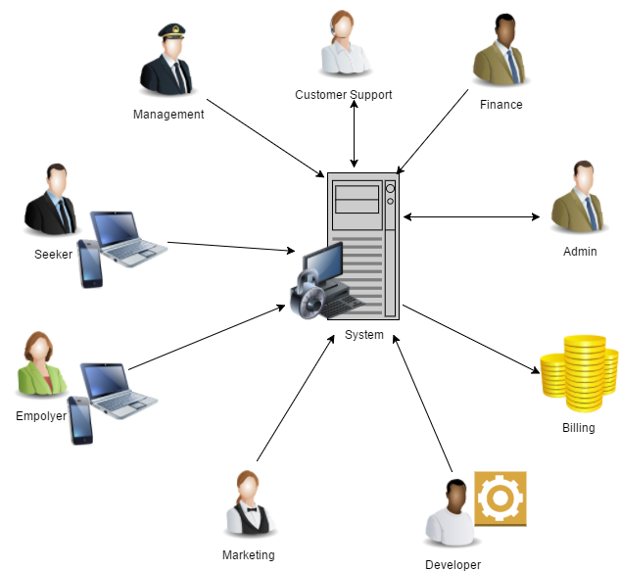
Service Strucure

Slide 5
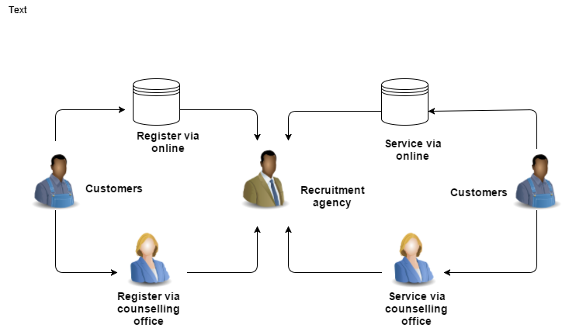
Basic Workflow Diagram

Slide 6
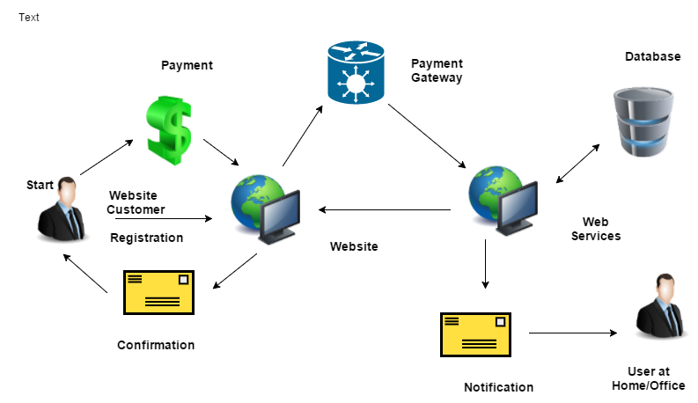
Extened Workflow Diagram

Slide 7
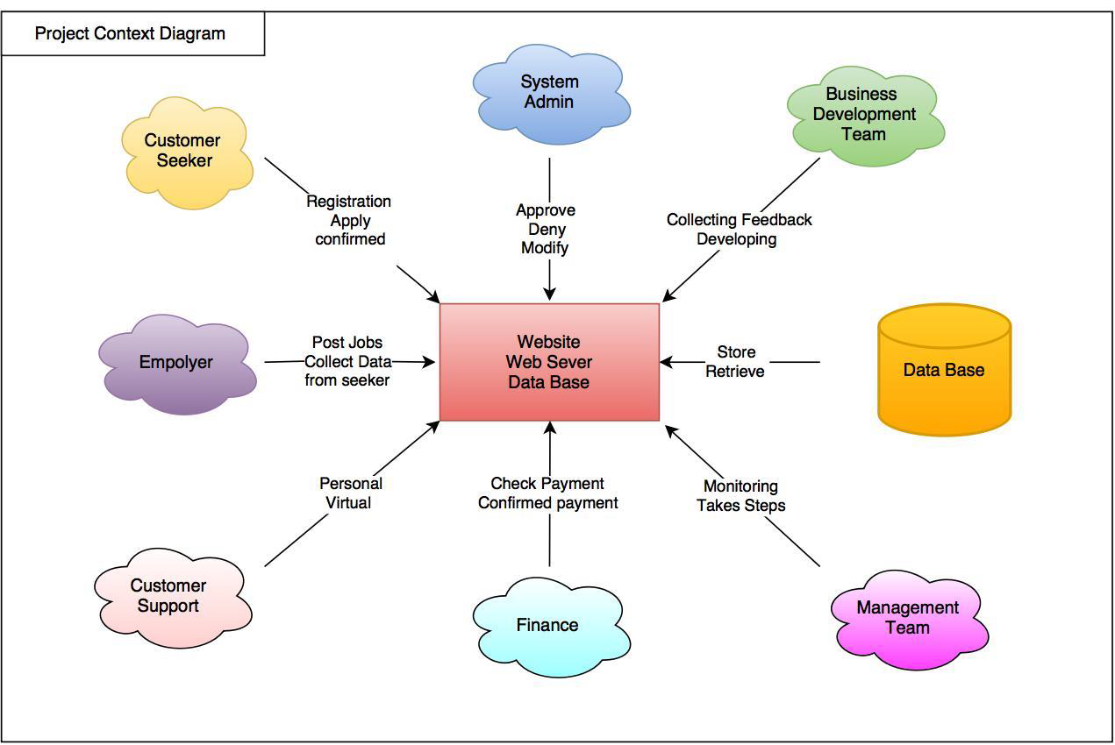

Slide 8
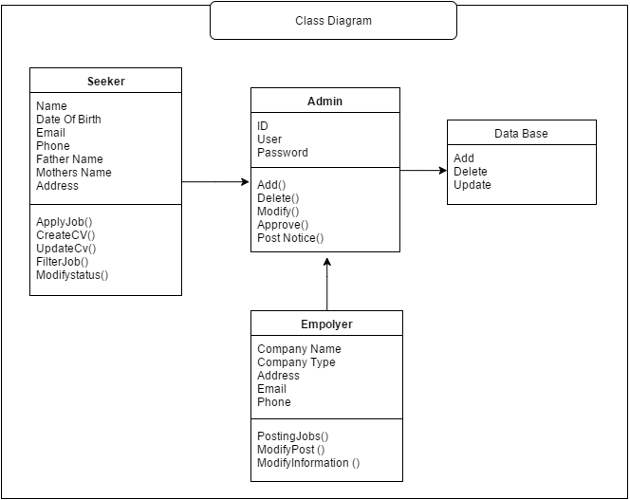

Slide 9
Proposed Methodologies
Brainstorming about the project
Developing idea and design project plan
Conduct Requirement Engineering Process
Implement Strategic IT Planning
Implement BPMN 2.0
Implement Six Sigma
Technical Demo

